Slide 1


TopTagger, DeepAK8, event Mva comparison

Slide 2
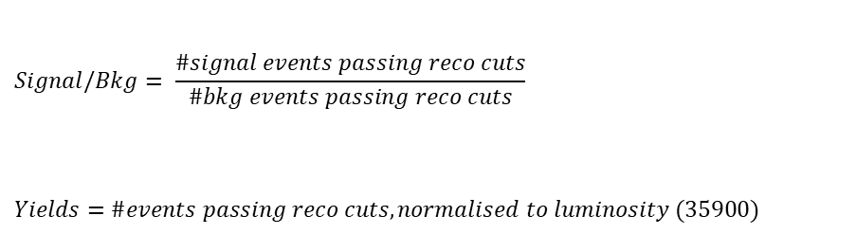
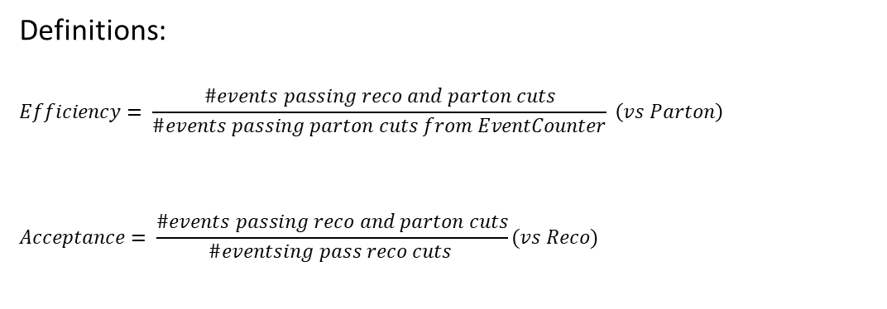
Overview
Efficiencies and Acceptance for mTT and jetPt variables
Selection:
Jet Matching
Parton cuts:
partonPt[0],[1] > 400
|partonEta[0],[1]| < 2.4
mTTbarParton > 1000
Reco cuts:
nJets > 1
nLeptons = 0
mJJ > 1000
jetPt[0],[1] > 400
|jetEta[0],[1]| < 2.4
bTagging (Medium WP)
Tagger cut (event mva, top Tagger, deepAK8)
JetMassSoftDrop > 120 and < 220
Definitions:
$$Efficiency= \frac{\#events passing reco and parton cuts}{\#events passing parton cuts from EventCounter} \left(vs Parton\right)$$
$$Acceptance= \frac{\#events passing reco and parton cuts}{\#eventsing pass reco cuts }(vs Reco)$$
$$Signal/Bkg= \frac{\#signal events passing reco cuts}{\#bkg events passing reco cuts}$$
$$Yields=\#events passing reco cuts, normalised to luminosity (35900)$$

Slide 3
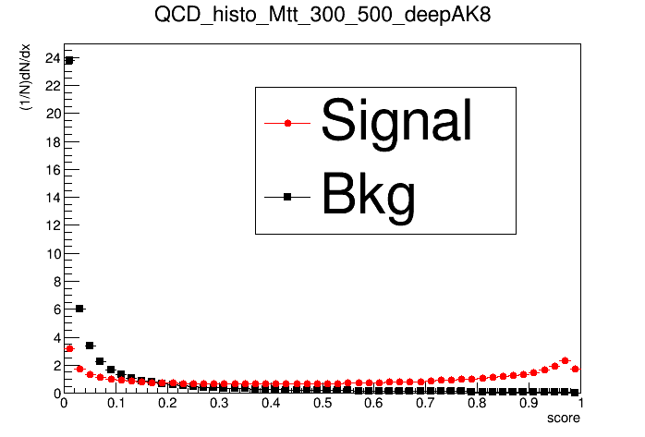
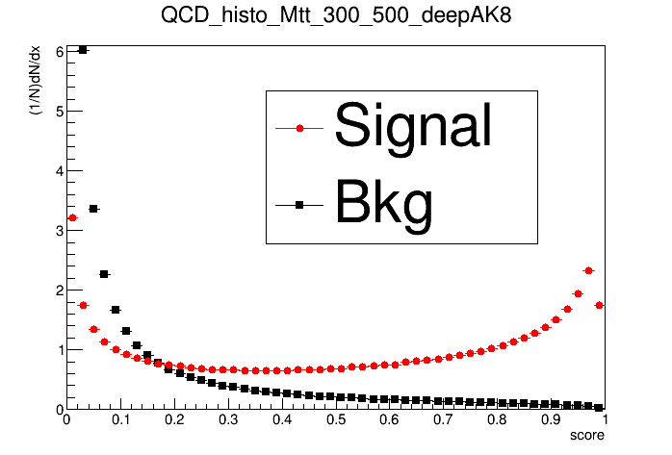
TopTagger, DeepAK8 comparison
Zoomed in

Slide 4
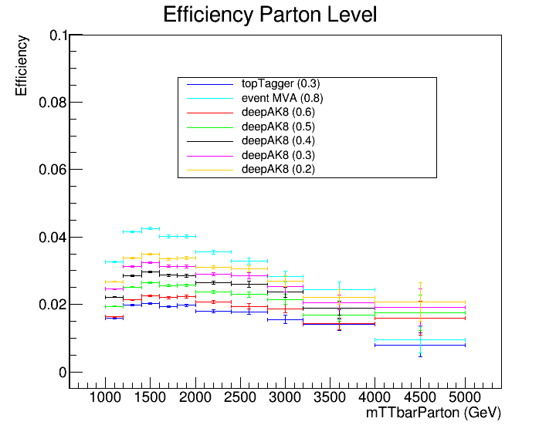
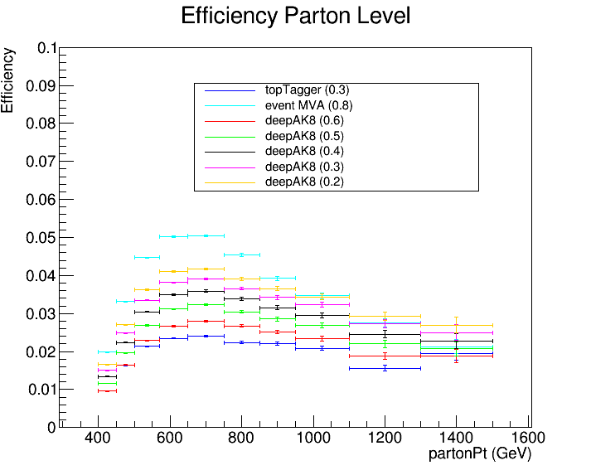
TopTagger, DeepAK8, event MVA Efficiency comparison

Slide 5
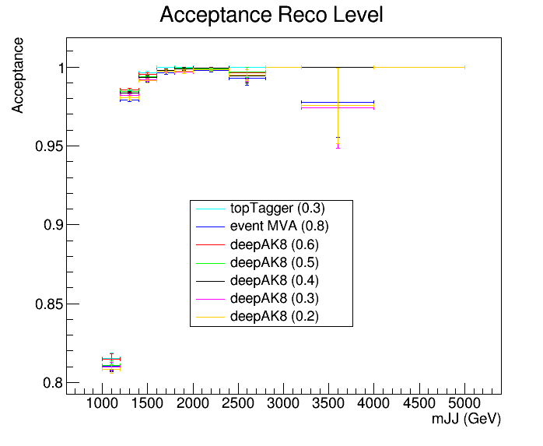
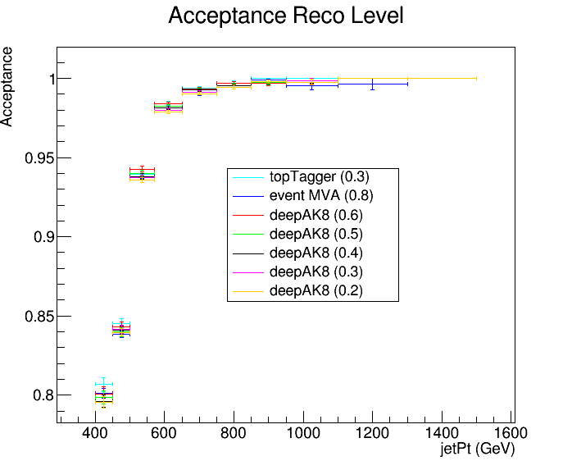
TopTagger, DeepAK8, event MVA Acceptance comparison

Slide 6
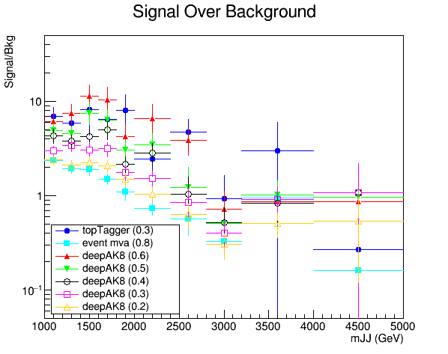
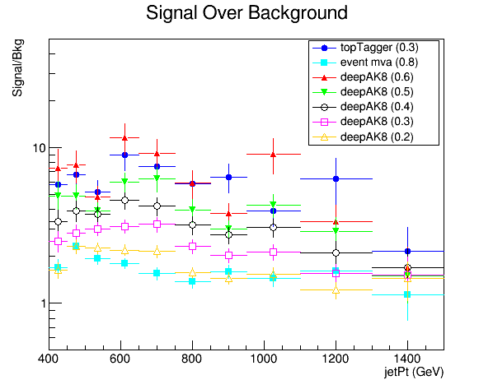
TopTagger, DeepAK8 comparison

Slide 7
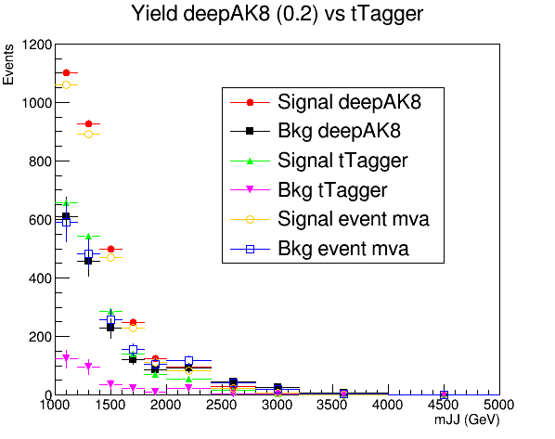
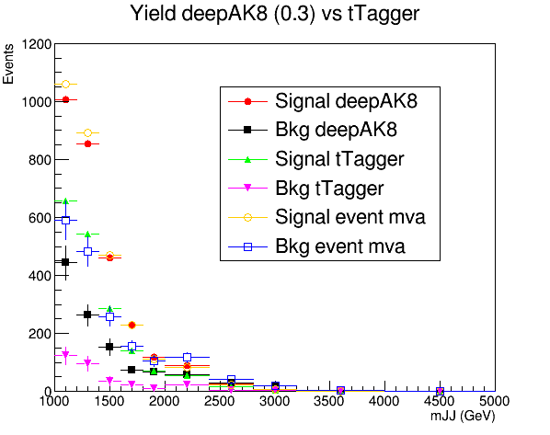
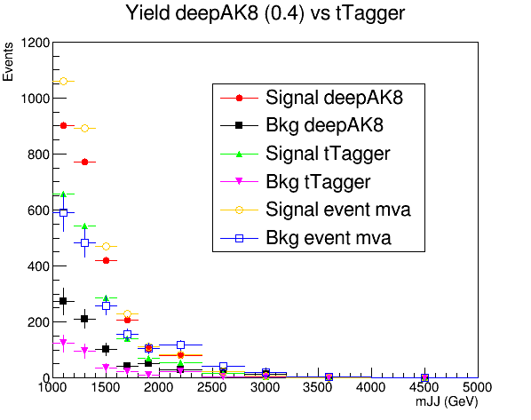
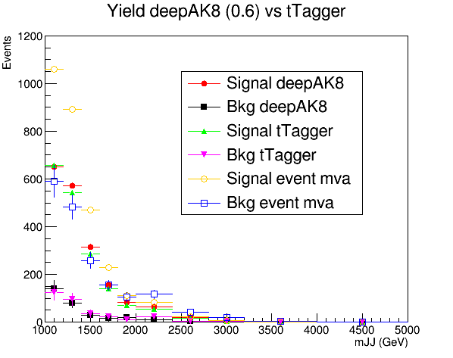
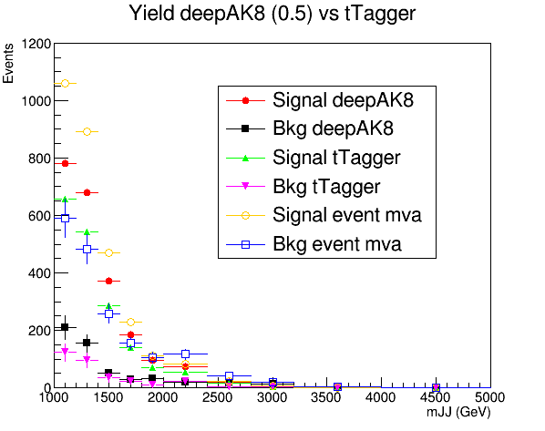

Slide 8
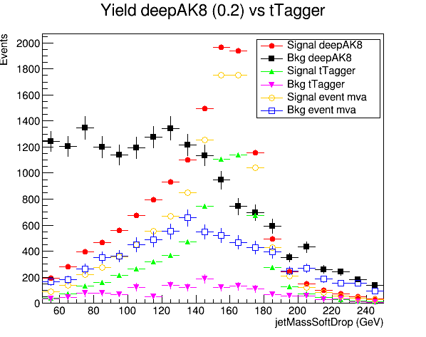
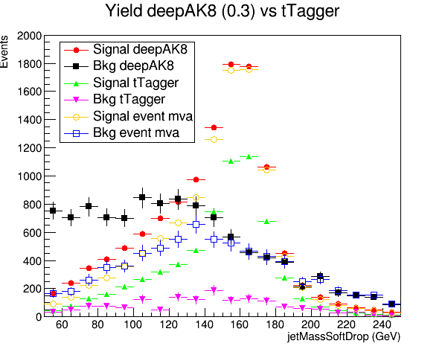
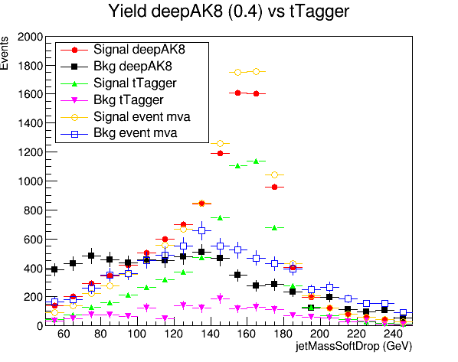
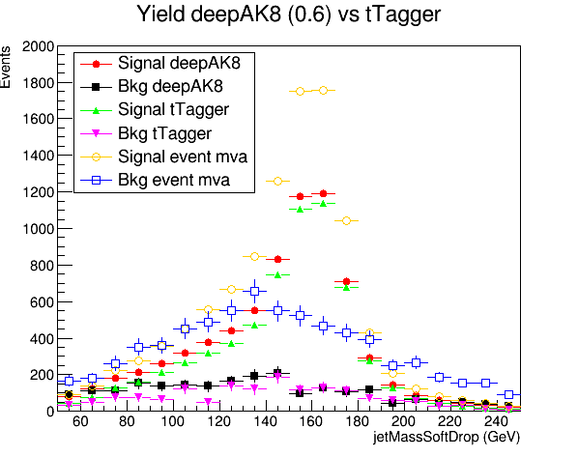
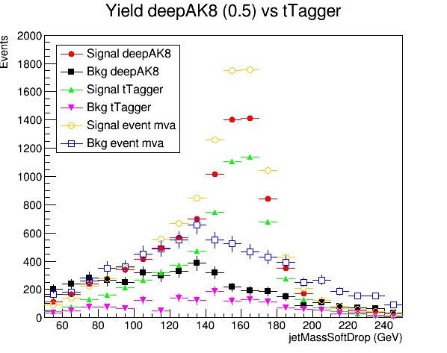

Slide 9
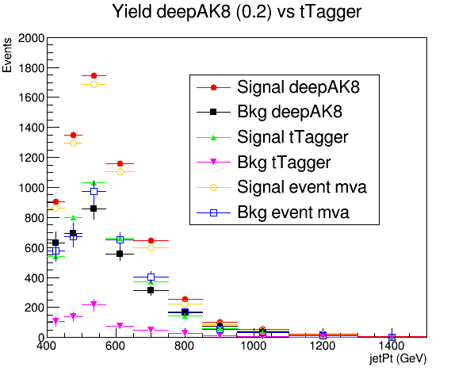
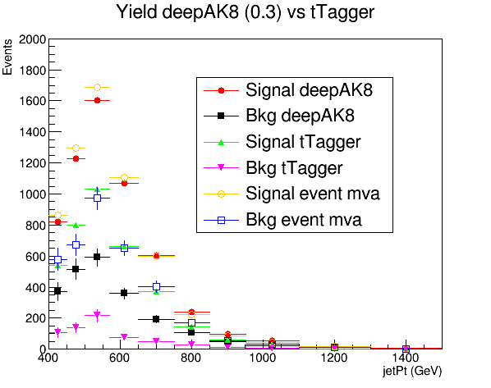
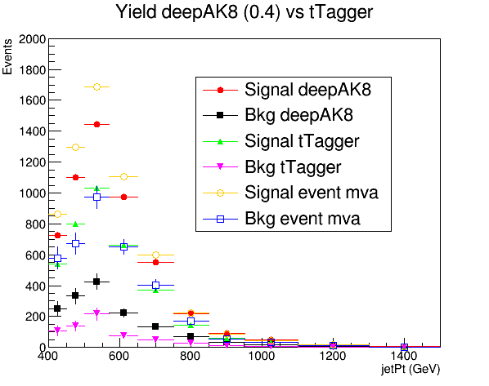
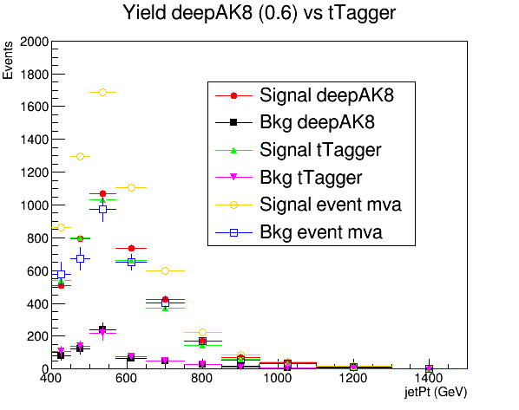
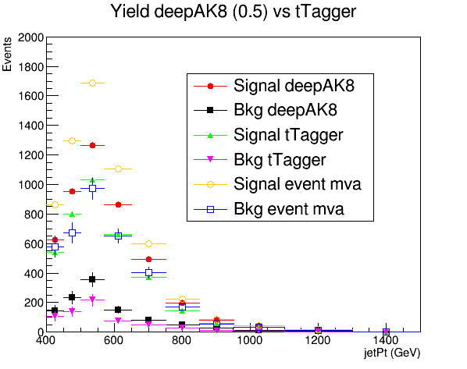

Slide 10
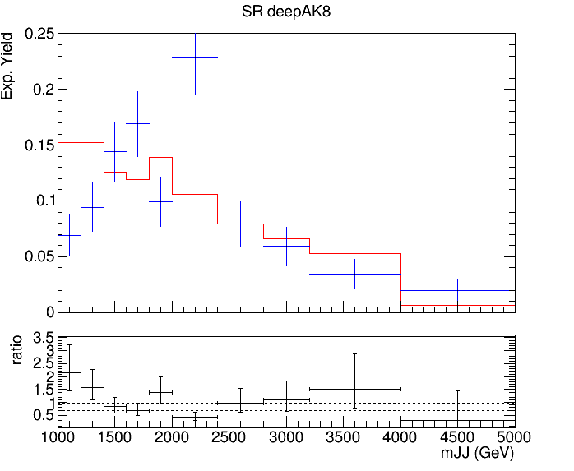
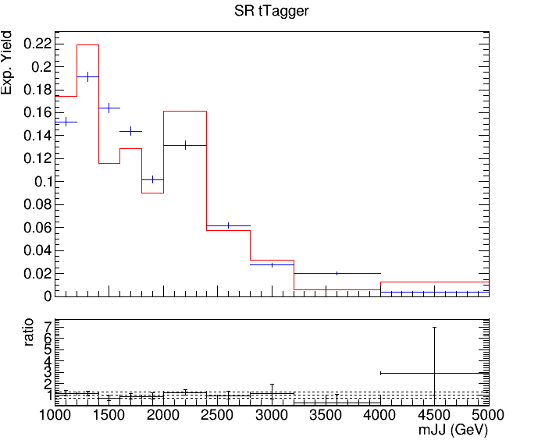
QCD Closure Tests

